Slide 1

AI for Multi-period Inventory Optimization with Uncertain Demand
Prepared by Pratik Kumar Mitra (20810082) under the guidance of Prof. Manu K. Gupta

Slide 2


Introduction
Inventory Decisions are generally based on EOQ formula as given below: $\boxed{EOQ= \sqrt{(2∗D∗S)/H}}$
When faced with lead times, retailers also use the below formula to determine minimum inventory levels:
Safety Stock = Average lead-time * average demand
But in both the above cases, demand and lead times need to be deterministic or at least their distributions need to be known.

Slide 3

Objectives of the project
Create a robust, Q-Learning agent to learn the inventory decisions for uncertain demands across multiple periods.
Compare the agent's performance initially for known demand distributions against the optimum policy generated using the Value Iteration method.
Compare the agent's performance for actual demand values against standard inventory replenishment strategies.
Test for scalability and robustness.

Slide 4

Sequential Decision Model
A Sequential Decision model is made up of the following key elements –
A set of decision instances
A set of system states
A set of available actions
A set of immediate rewards for each particular state-action combination
A set of transition probabilities for each state-action combination

Slide 5
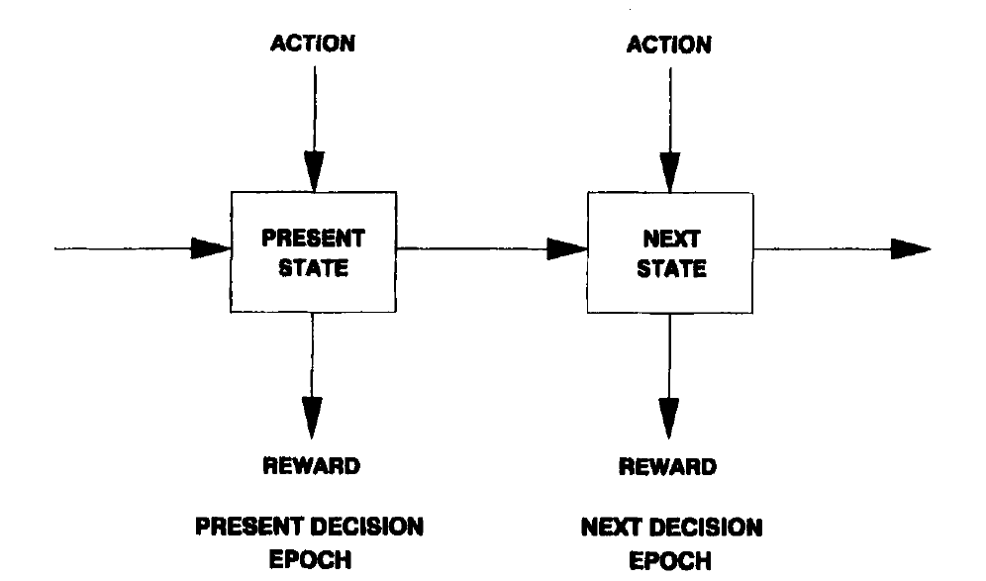
Sequential Decision Model

Slide 6


Markovian Decision Problem
Symbolically, the Markov Decision Problem is represented as:
$$(S,A,T,R,γ)$$
S represents the set of all available states
A represents the set of available actions
T represents the transition function
R is the reward function
γ represents the discounting factor

Slide 7
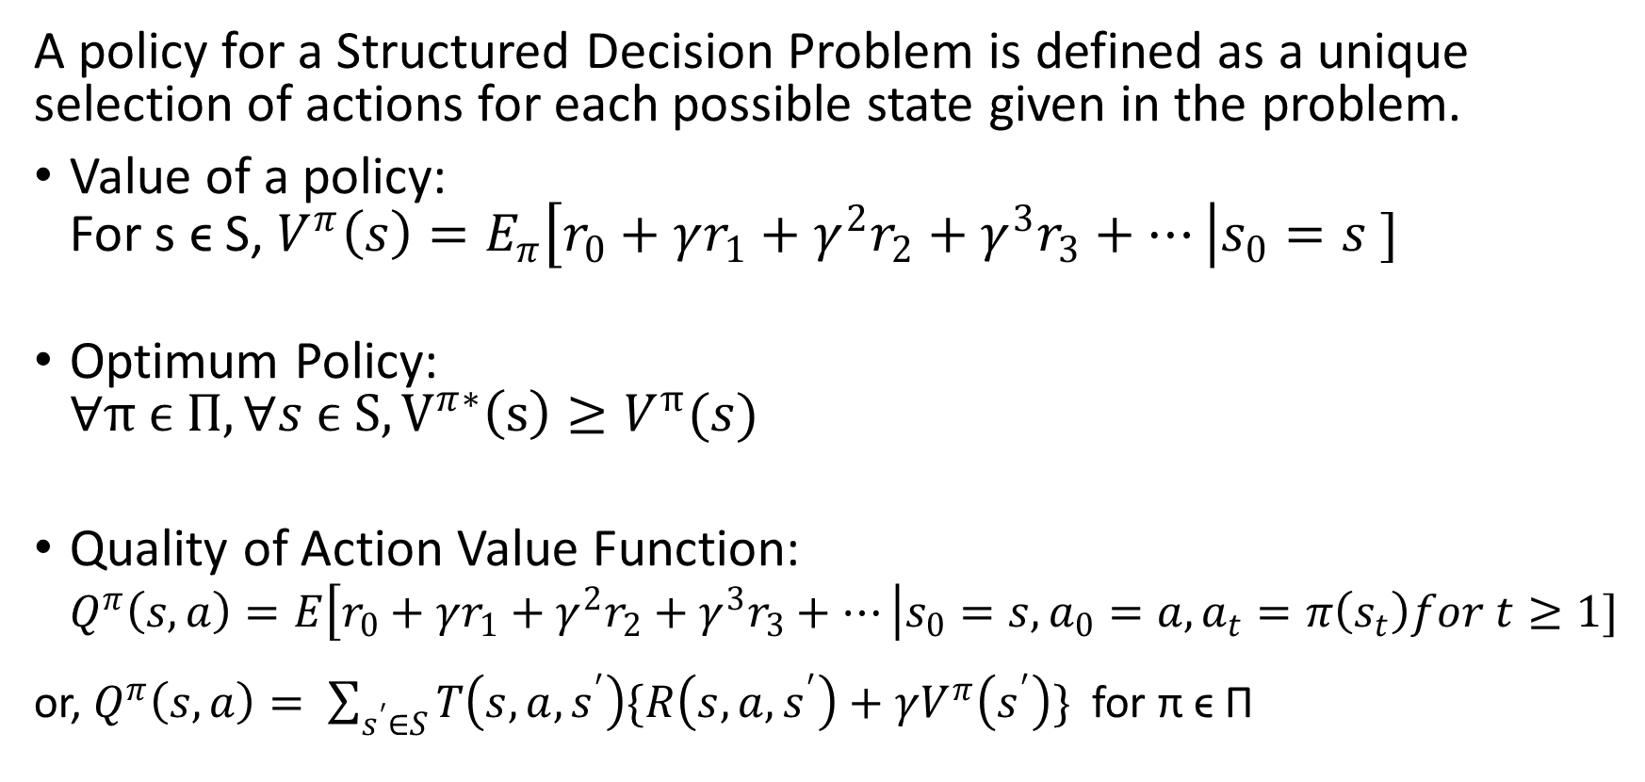
Markovian Decision Problem (contd.)
A policy for a Structured Decision Problem is defined as a unique selection of actions for each possible state given in the problem.
Value of a policy: For s ϵ S, $V^{π}\left(s\right)=E_{π}\left[r_{0}+γr_{1}+γ^{2}r_{2}+γ^{3}r_{3}+…\right|s_{0}=s ]$
Optimum Policy: $∀π ϵ Π, ∀s ϵ S, V^{π∗}\left(s\right)≥V^{π}(s)$
Quality of Action Value Function: $Q^{π}\left(s,a\right)=E\left[r_{0}+γr_{1}+γ^{2}r_{2}+γ^{3}r_{3}+…\right|s_{0}=s, a_{0}=a,a_{t}=π\left(s_{t}\right)for t≥1]$
or, $Q^{π}\left(s,a\right)= \sum_{s^{′}∈S}{T\left(s,a,s^{′}\right)\{R\left(s,a,s^{′}\right)+γV^{π}\left(s^{′}\right)\} }$ for π ϵ Π

Slide 8

Reinforcement Learning
This Photo by Unknown Author is licensed under CC BY-SA-NC

Slide 9
Environment Definition
Lambda – The mean of the Poisson demand distribution
M – The capacity of the warehouse or the maximum inventory allowed.
K – The fixed cost of placing an order.
alpha – The per unit ordering cost over and above the fixed cost.
beta – The variable holding cost of each inventory unit per time period.
gamma – The discounting factor used in the problem.
delta – The revenue realized per unit of sales.

Slide 10
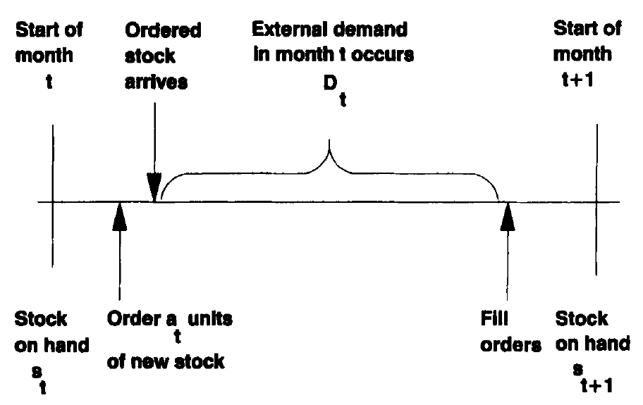
Modelling the problem

Slide 11
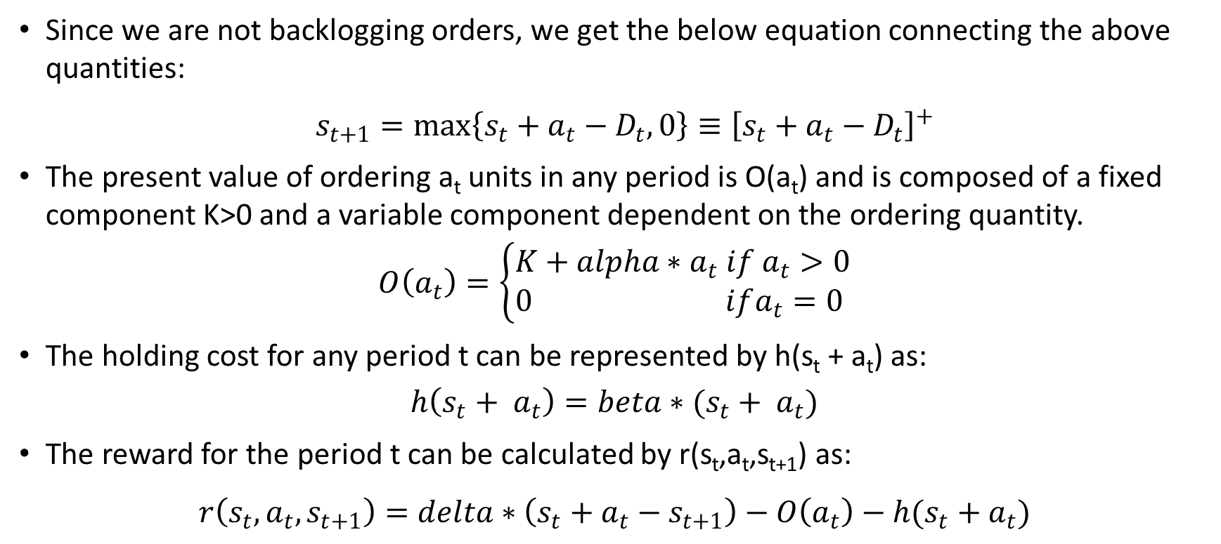
Equations connecting the quantities
Since we are not backlogging orders, we get the below equation connecting the above quantities:
$s_{t+1}=\max\left\{s_{t}+a_{t}−D_{t}, 0\right\}≡{\left[s_{t}+a_{t}−D_{t}\right]}^{+}$
The present value of ordering a_{t} units in any period is O(a_{t}) and is composed of a fixed component K>0 and a variable component dependent on the ordering quantity.
$$O\left(a_{t}\right)=\left\{\begin{aligned}K+alpha∗a_{t} if a_{t}>0 \\ 0 ifa_{t}=0 \end{aligned}\right.$$
The holding cost for any period t can be represented by h(s_{t} + a_{t}) as:
$$h\left(s_{t}+ a_{t}\right)=beta∗(s_{t}+ a_{t})$$
The reward for the period t can be calculated by r(s_{t},a_{t},s_{t+1}) as:
$r\left(s_{t},a_{t},s_{t+1}\right)=delta∗\left(s_{t}+a_{t}−s_{t+1}\right)−O\left(a_{t}\right)−h(s_{t}+a_{t})$

Slide 12
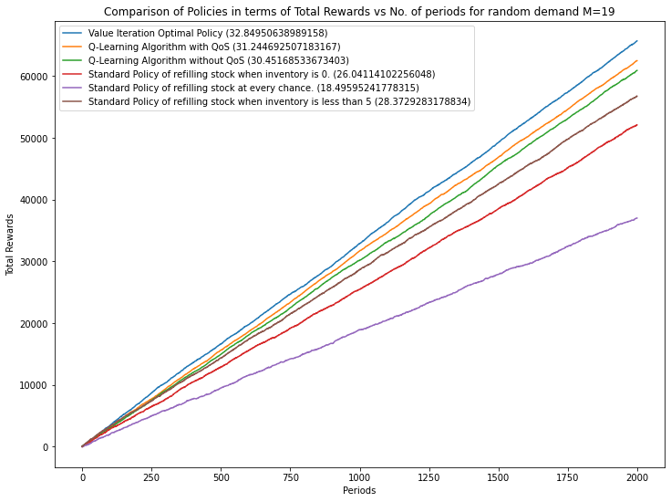
Results
Graph showing the performance of various policies for random demand and inventory capacity of 19.

Slide 13
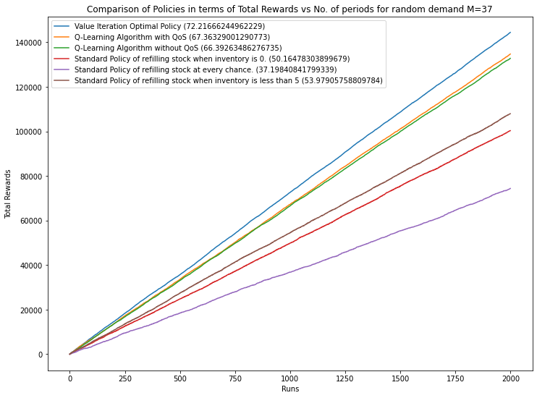
Results
Graph showing the performance of various policies for random demand and inventory capacity of 37.

Slide 14
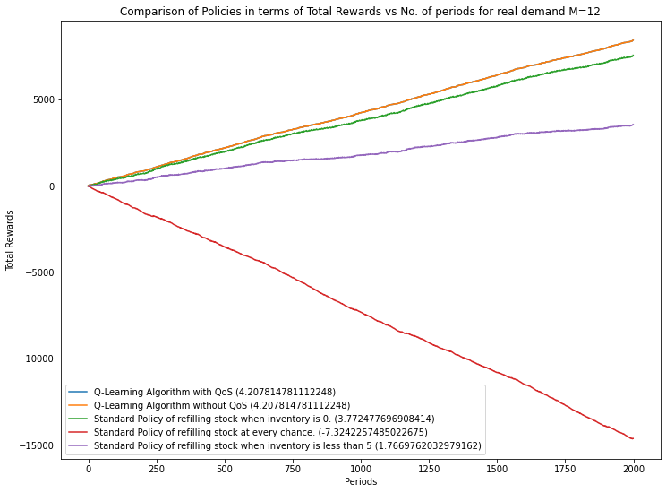
Results
Graph showing the performance of various policies for actual demand and inventory capacity of 12.

Slide 15
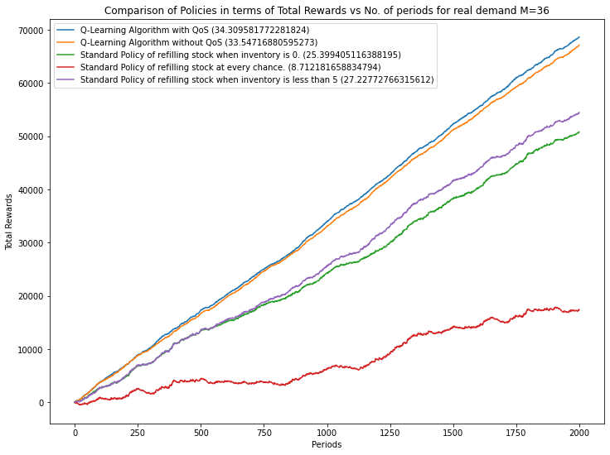
Results
Graph showing the performance of various policies for actual demand and inventory capacity of 36.

Slide 16

Conclusion
The algorithm performs as expected when tested against random and real demand data. We have also tested the algorithm's robustness by implementing the same for various values of inventory capacity.
We can implement the same concept for managing multi-product inventory models in the future. Another avenue for future improvement is to generalize each of the simplifying assumptions we considered to build the model to build a more generalized model to model the real-world scenarios better.

Slide 17

Thank You.

